Slide 1

Colorado Alternative Fuel Station Dashboard
Noah Laraway Mike welch
Gabriel Allen Ric Martinez

Slide 2

Contents
Executive Summary
Alternative Fuels
Overall Dashboard
Interactive Visualizations
Conclusion
Appendix A
Resources

Slide 3



Executive summary
Due to government regulation and consumers demand for cleaner fuel sources, alternative fuel vehicle sales are forecasted to increase dramatically in the coming years. According to a recent analysis global annual sales for electric vehicles are expected to increase from 2.5 million in 2020 to 12.2 million in 2025.
There will need to be an increase in charging stations to accommodate the growing usage of alternative fuel vehicles. The global electric vehicle charging station market size is projected to reach 30,758 thousand stations by 2027, up from an estimated 2,115 thousand units in 2020.
This project focuses on the availability of alternative fuel stations in Colorado and develops an easy to use dashboard to find stations by area and fuel type.
Potential Use of Dashboard
Eco-friendly car dealerships
Adaptable charging station info for specific car models (Tesla Owners)
Usage by CDOT to facilitate increased use of alternative fuel vehicles
Utility company usage to identify potential zip codes and cities for future stations
Adaptable use for RTD for park and ride users
Usage by electric trucking companies for logistical purposes

Slide 4
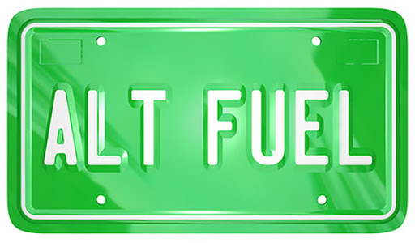
Alternative Fuels
What are alternative fuel vehicles?
According to the US Department of Energy: Alternative fuel vehicles are “A dedicated, flexible fuel, or dual-fuel vehicle designed to operate on at least one alternative fuel.”
Alternative fuel vehicle types
Electric
E-85
Biodiesel
CNG
LPG

Slide 5
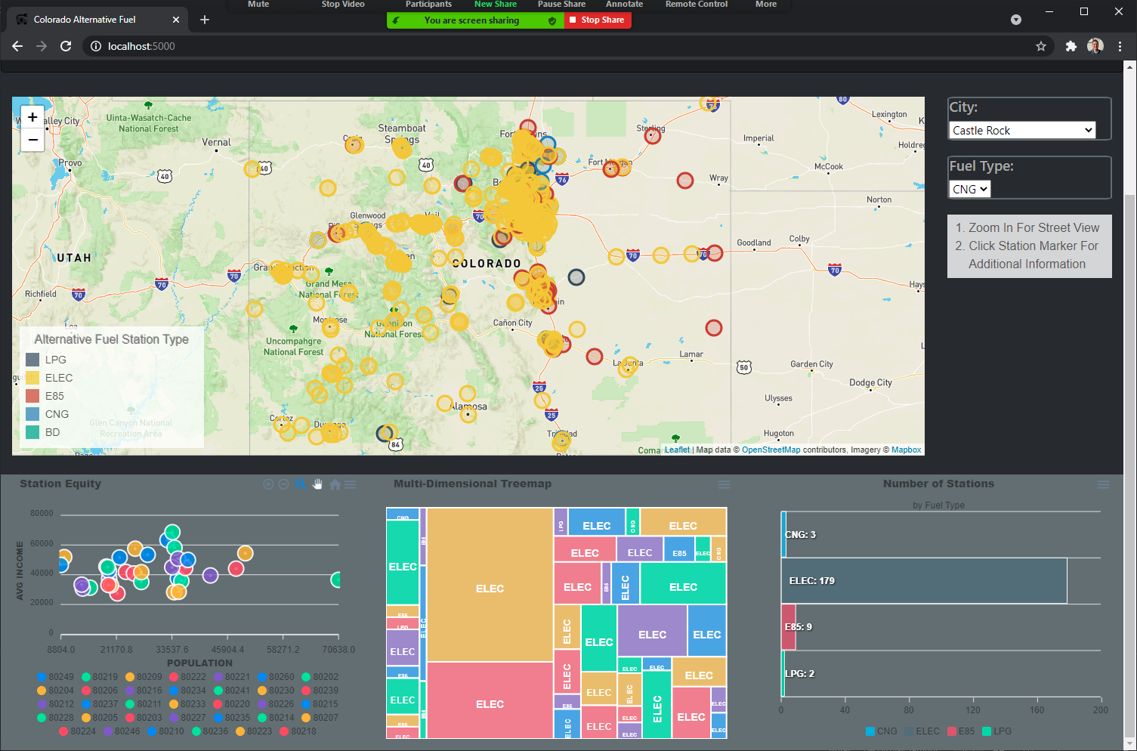
Overall dashboard
Data Overview
957 Charging stations in Colorado
Location
Lat/Lon
Zip Code
City
Fuel type
Area demographics by zip code
Average household income
Population
Interactive Visuals
Colorado charging stations map
Demographics bubble chart
Fuel station type treemap
Station count bar chart by city
Dropdown boxes to filter on city and fuel type

Slide 6
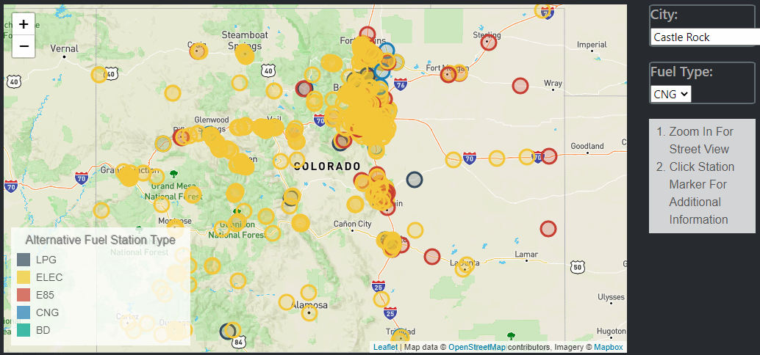
Interactive Visualizations
Colorado Alternative Fuel Stations Map

Slide 7
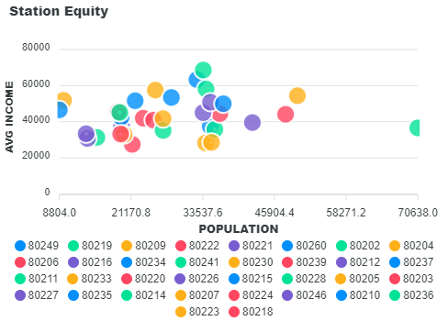
Interactive Visualizations
Bubble Chart
Shows population vs. average household income
Bubbles are stations for each zip code

Slide 8
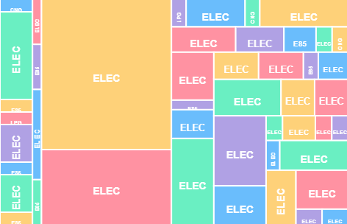
Interactive Visualizations
Tree Map
Shows station count by zip code and fuel type for each city
Each block is a unique zip code/fuel type combination.

Slide 9
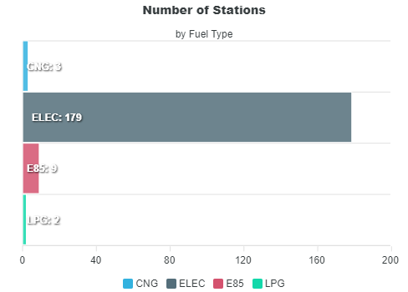
Interactive Visualizations
Bar Chart
Shows station count by fuel type for each city

Slide 10
Conclusions
Alternative fuel vehicles and charging stations will increase dramatically in usage in the near future.
01
Zip codes with higher average household incomes do not appear to have more alternative fueling stations. A more in-depth analysis should be performed to confirm.
02
There’s enormous potential for use of an alternative fuel station dashboard with a diverse number of applications.
03

Slide 11
APPENDIX A
Resources
Businesswire: Business Wire, a Berkshire Hathaway company, is the global leader in press release distribution and regulatory disclosure.
IHS Markit: IHS Markit is a dynamic team that includes more than 5,000 analysts, data scientists, financial experts and industry specialists. Our global information expertise spans numerous industries, including leading positions in finance, energy and transportation.
US Department of Energy: The mission of the Energy Department is to ensure America’s security and prosperity by addressing its energy, environmental and nuclear challenges through transformative science and technology solutions.
Colorado.Gov: Public website for the state of Colorado
World Population Review: Most demographic data is hidden in spreadsheets, behind complex APIs, or inside cumbersome tools. World Population Review's goal is to make this data more accessible through graphs, charts, analysis and visualizations. We also strive to present the most recent information available, and develop our own projections based on recent growth.
Zip Atlas: Zip Atlas is a structured collection of zip code, area code, city and state demographic, social and economic profiles.

